Slide 1
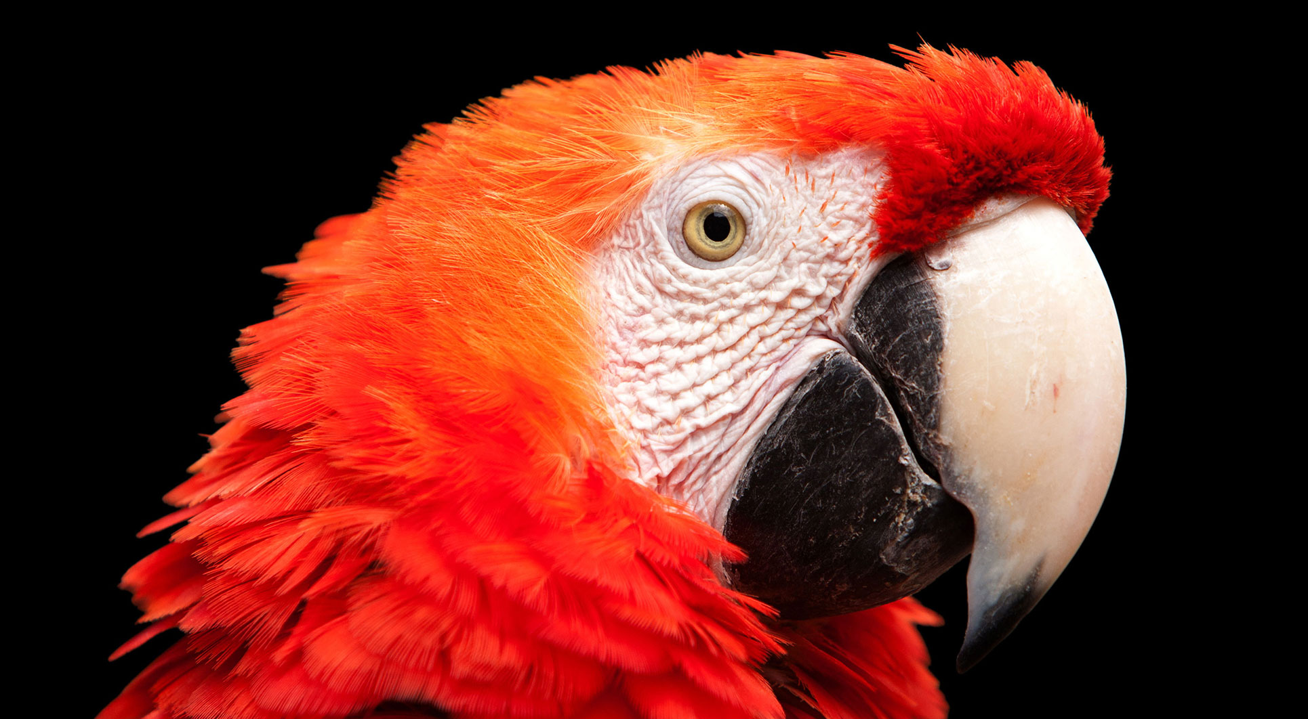
6.2 函数变量与参数
《Python青少年趣味编程》
小牛叔出品

Slide 2
1、变量也可以装下函数
def sayHappy(name):
print("Happy Birthday:"+ name)
sayHappy('Queen')
sayHappy('King’)
sh = sayHappy
sh('zhang')

Slide 3
2、参数当中使用函数
def sayHappy(name):
print("Happy Birthday:"+ name)
def sayHello(name):
print("Good days:"+ name)
def meet(name,say):
print('You meet ' + name)
say(name)
meet('zhang',sayHappy)
meet('zhang',sayHello)

Slide 4
3、参数的名称调用方式
def sayHello(name,week='',weather=''):
print("Hello " + name + ". ",end = '')
print(("Wish you have a nice " + week + ". ")
if week !='' else '',end = '')
print(("We have a " + weather + " day,isn't it?") if weather !='' else ’’)
sayHello('zhang')
sayHello('zhang','Friday','good')
sayHello(name = 'zhang',weather = 'fine')
sayHello('zhang',week='Monday')

Slide 5
4、 *运算
def sayHello(*args):
for name in args:
print("Hello "+ name)
sayHello()
sayHello('Herny','Partinton')
sayHello('Herny','Partinton','Tony Spark')

Slide 6
5、 **运算
def sayHello(**args):
print(args)
print('Hello ' + args['name'])
print('We have a ' + args['weather'] + ' day')
print('What a nice ' + args['week'] + ' today')
sayHello(name="Joe",week="Monday",weather="sunny")

